Slide 1
Northwind Analysis
Rakha Kahansa Putra
Kelompok 6
DSLS 2023 – Mini Project DE

Slide 2
Levels of Analysis & Business Value
Discount
Effects of Discount on Customer Order
How to maximize Profits through Discount
Product
Products Profitability Analysis
Price Over Quantity per Product Category
Region
Customer Region Effects on Sales
Supplier Region Effects on Sales

Slide 3
Executive Summary
Discount statistically increase Quantity of Orders
Profitability have good correlation with Average Unit Price
Biggest Customers is USA & Biggest Supplier is Germany and France
Some Action Needs to be Taken for Some Product Category

Slide 4
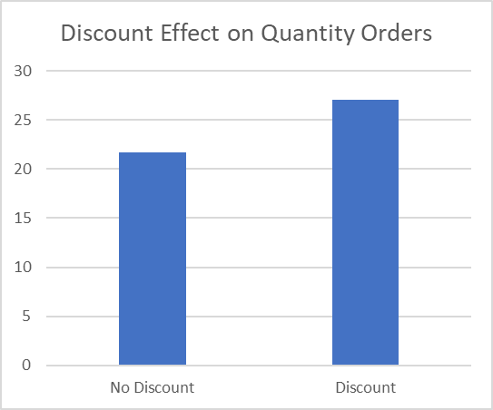
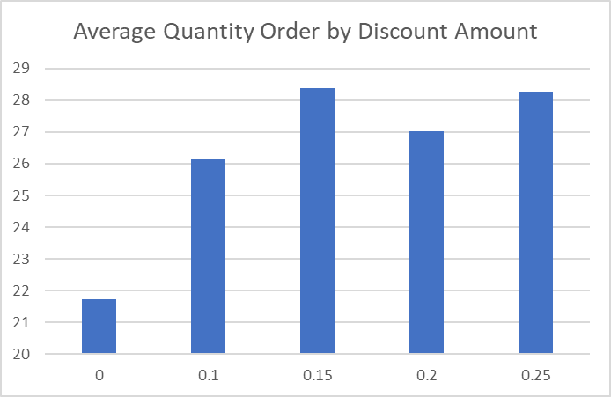
Discount Effect on Quantity Orders
Putting Discount statistically increase Quantity of Orders.
Quantity of Orders with Discount increase 24.8% Relatively compared to No Discount
Discount 15% - 25% is the optimum range to increase Quantity Order

Slide 5
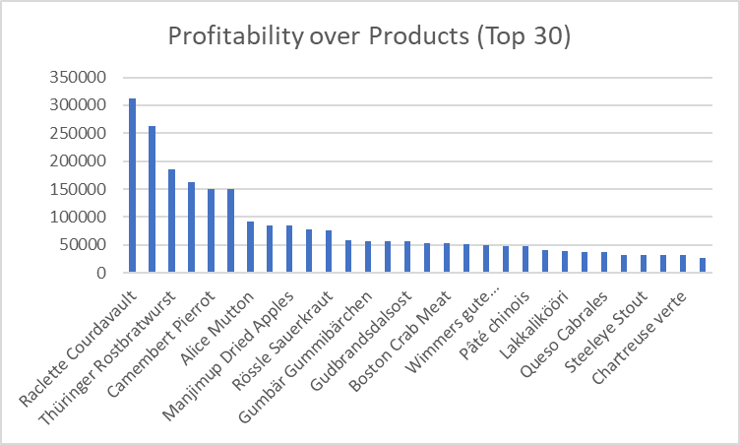
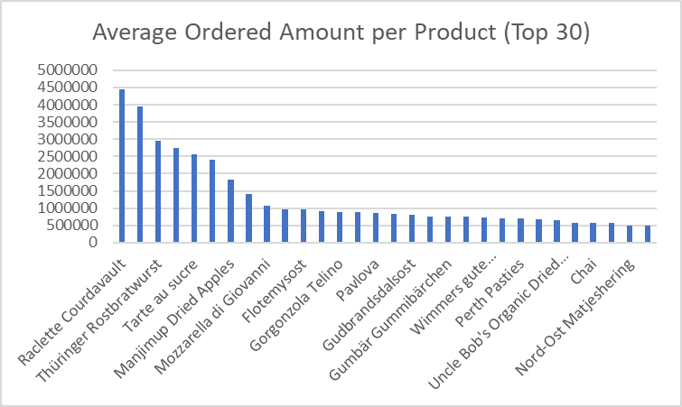
Most Profitable Products
Profitability have good correlation with Higher Average Unit Price

Slide 6
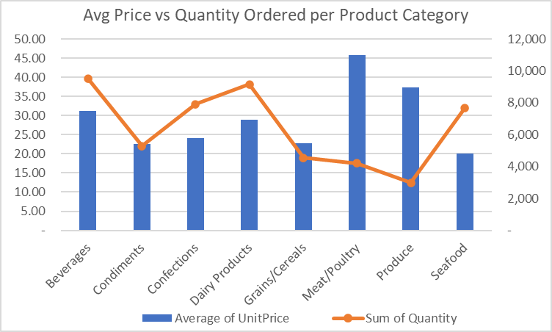
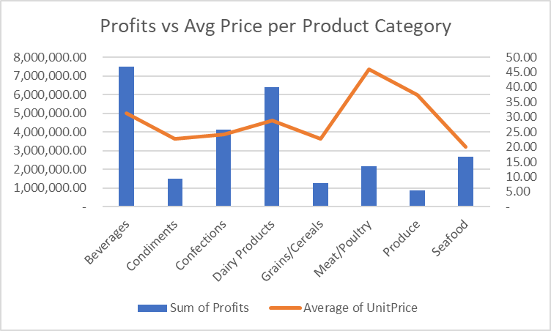
Product Category Findings
Meat/Poultry & Produce low quantity orders due to higher price compare to other category
Seafood has low profitability even with high quantity of orders. This is due to Seafood has low average of unit price

Slide 7
Where to put the Discount?
Increase Unit Price in Seafood -> Increase Profitability. Because from quantity ordered, seafood seems have a high demand.
Putting discount on this Meat/Poultry & Produce -> increase quantity orders -> higher profitability

Slide 8
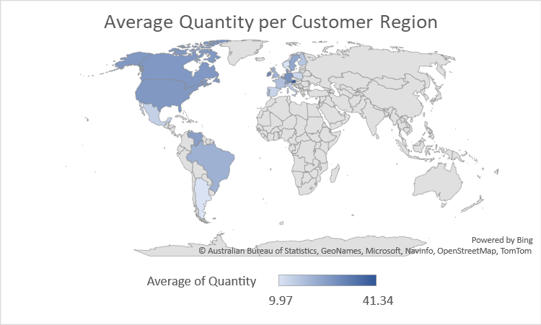
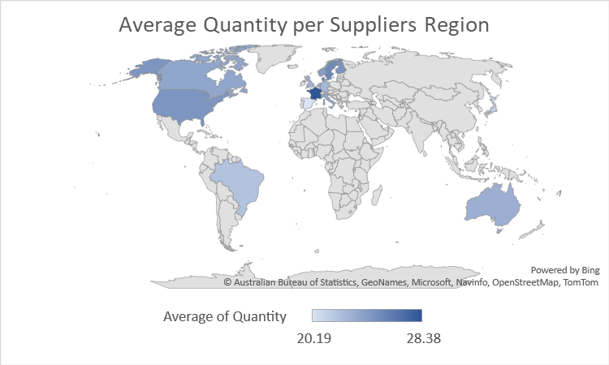
Quantity on Customer and Supplier Region

Slide 9
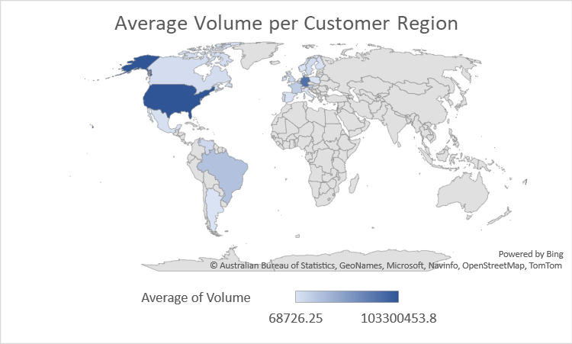
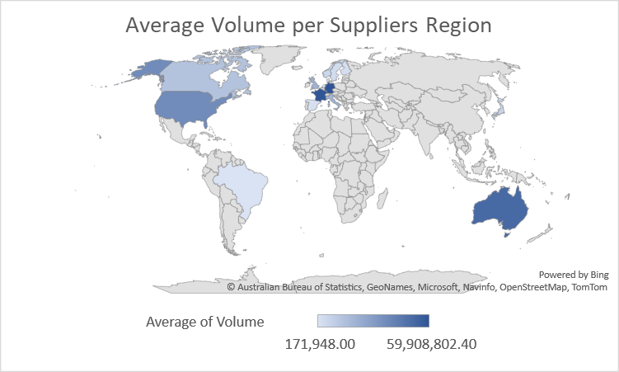
Volume Sales on Customer and Supplier Region
Biggest Customer is from North America (USA)
Biggest Supplier is from West Europe (France & Germany)
Australia is the only country that supplies without having any order

Slide 10
Business Recommendation
Give Discount in Meat/Poultry & Produce Product
Increase Quantity Order and Boost Profitability
Give 15% - 25% Discounts on Segments Needed
Increase Quantity Order without hurting Profitability
Increase Price Unit for Seafood
Increase Profitability since Quantity is already high
Try to find markets on Countries that only Supplies.
New Opportunity in Selling New Products and Boost Volume Sales
Legends:
Action
Expected Impact

Slide 11
Appendix

Slide 12
SQL Querry
with orderdetails as(
select
a.orderid, productid, quantity, unitprice as costprice,
case when a.discount = 0 then 0 else 1 end as flag_discount,
case when a.discount <= 0.1 then 0.1 else a.discount end as discount
from order_details a
)
, supplier as(
select supplierid, country as suppliercountry
from suppliers
)
select *
from orders a
join customers b on a.CustomerID = b.CustomerID
join orderdetails c on a.orderid = c.orderid
join products d on c.productid = d.productid
join Categories e on d.categoryid = e.categoryid
join supplier f on d.supplierid = f.supplierid;

Slide 13
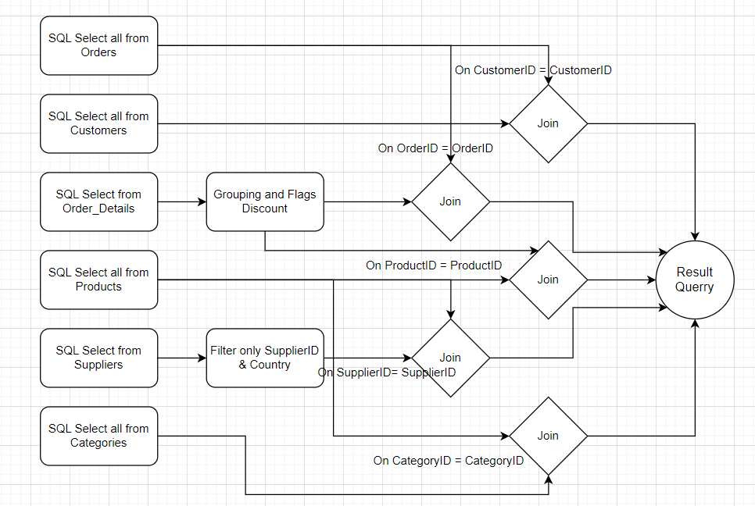
Querry Diagram / Flowchart

